Slide 1
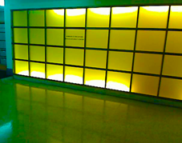
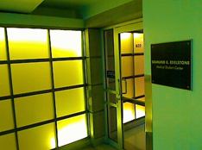
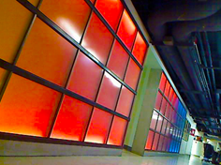
Technology At UIC & the College of Medicine

Slide 2
Helpdesk Staff
Chiquita, Anna, Victor
Helpdesk Office is located in B26 near the blue lockers
Computer help office hours: 9 am – 4:30 pm
Contact info
MDPChelp@uic.edu
http://chicago.medicine.uic.edu/education/student_services_support/computing

Slide 3
Classroom Staff
Tony, Darnell
Office is located in 315
Contact info
MDPChelp@uic.edu
http://chicago.medicine.uic.edu/education/student_services_support/

Slide 4
If you have problems
TELL someone
If we do not know we can not make it better
READ signs and directions
http://chicago.medicine.uic.edu/education/student_services_support
Notes:
If you have problems: Inform the Helpdesk for assistance

Slide 5
What do we do
Edelstone and classroom facilities
Computer Based Testing
Student computing support
Computer lab assistance
Departmental computer support
We do not run campus-wide systems

Slide 6
Our Services for Students
Assistance with computers, printers, scanner, and software in the student computer lab
Assistance with wireless access for the campus
Assistance with installing (virus protection software, and spyware) for personal computer
Advice on computer hardware or software purchases

Slide 7
How to get started
Set up for UIC Wifi
Subscribe to the Block calendar
Linked to from the UGME web
Read the Directions page
Read it again
Configure laptop for campus printing
UIC email account on Google Apps
Install AntiVirus

Slide 8
How to get started pt.2
Make sure you can access secure resources from off campus – like Histo web slides
http://accc.uic.edu/services/vpn
http://library.uic.edu/
Check out courses on Blackboard
Contact course directors as needed
Get the UIC app
Sign up for emergency text alerts http://sms.accc.uic.edu

Slide 9
Once you’ve settled in
Check out study spaces
Linked to from UGME web
http://chicago.medicine.uic.edu/education/m_d_student_life/facilities/conference_and_study_rooms
AntiSpyware
Spybot, AdAware
http://download.cnet.com
We are available for help!

Slide 10
Community issues
Consideration for others
Lost and Found
OSA main desk, Student Center West
Temperatures
Variable - hot or cold
Wear layers if needed
Doors
Do Not Prop Open
Move sign to Unoccupied
Electrical
Limited # outlets

Slide 11
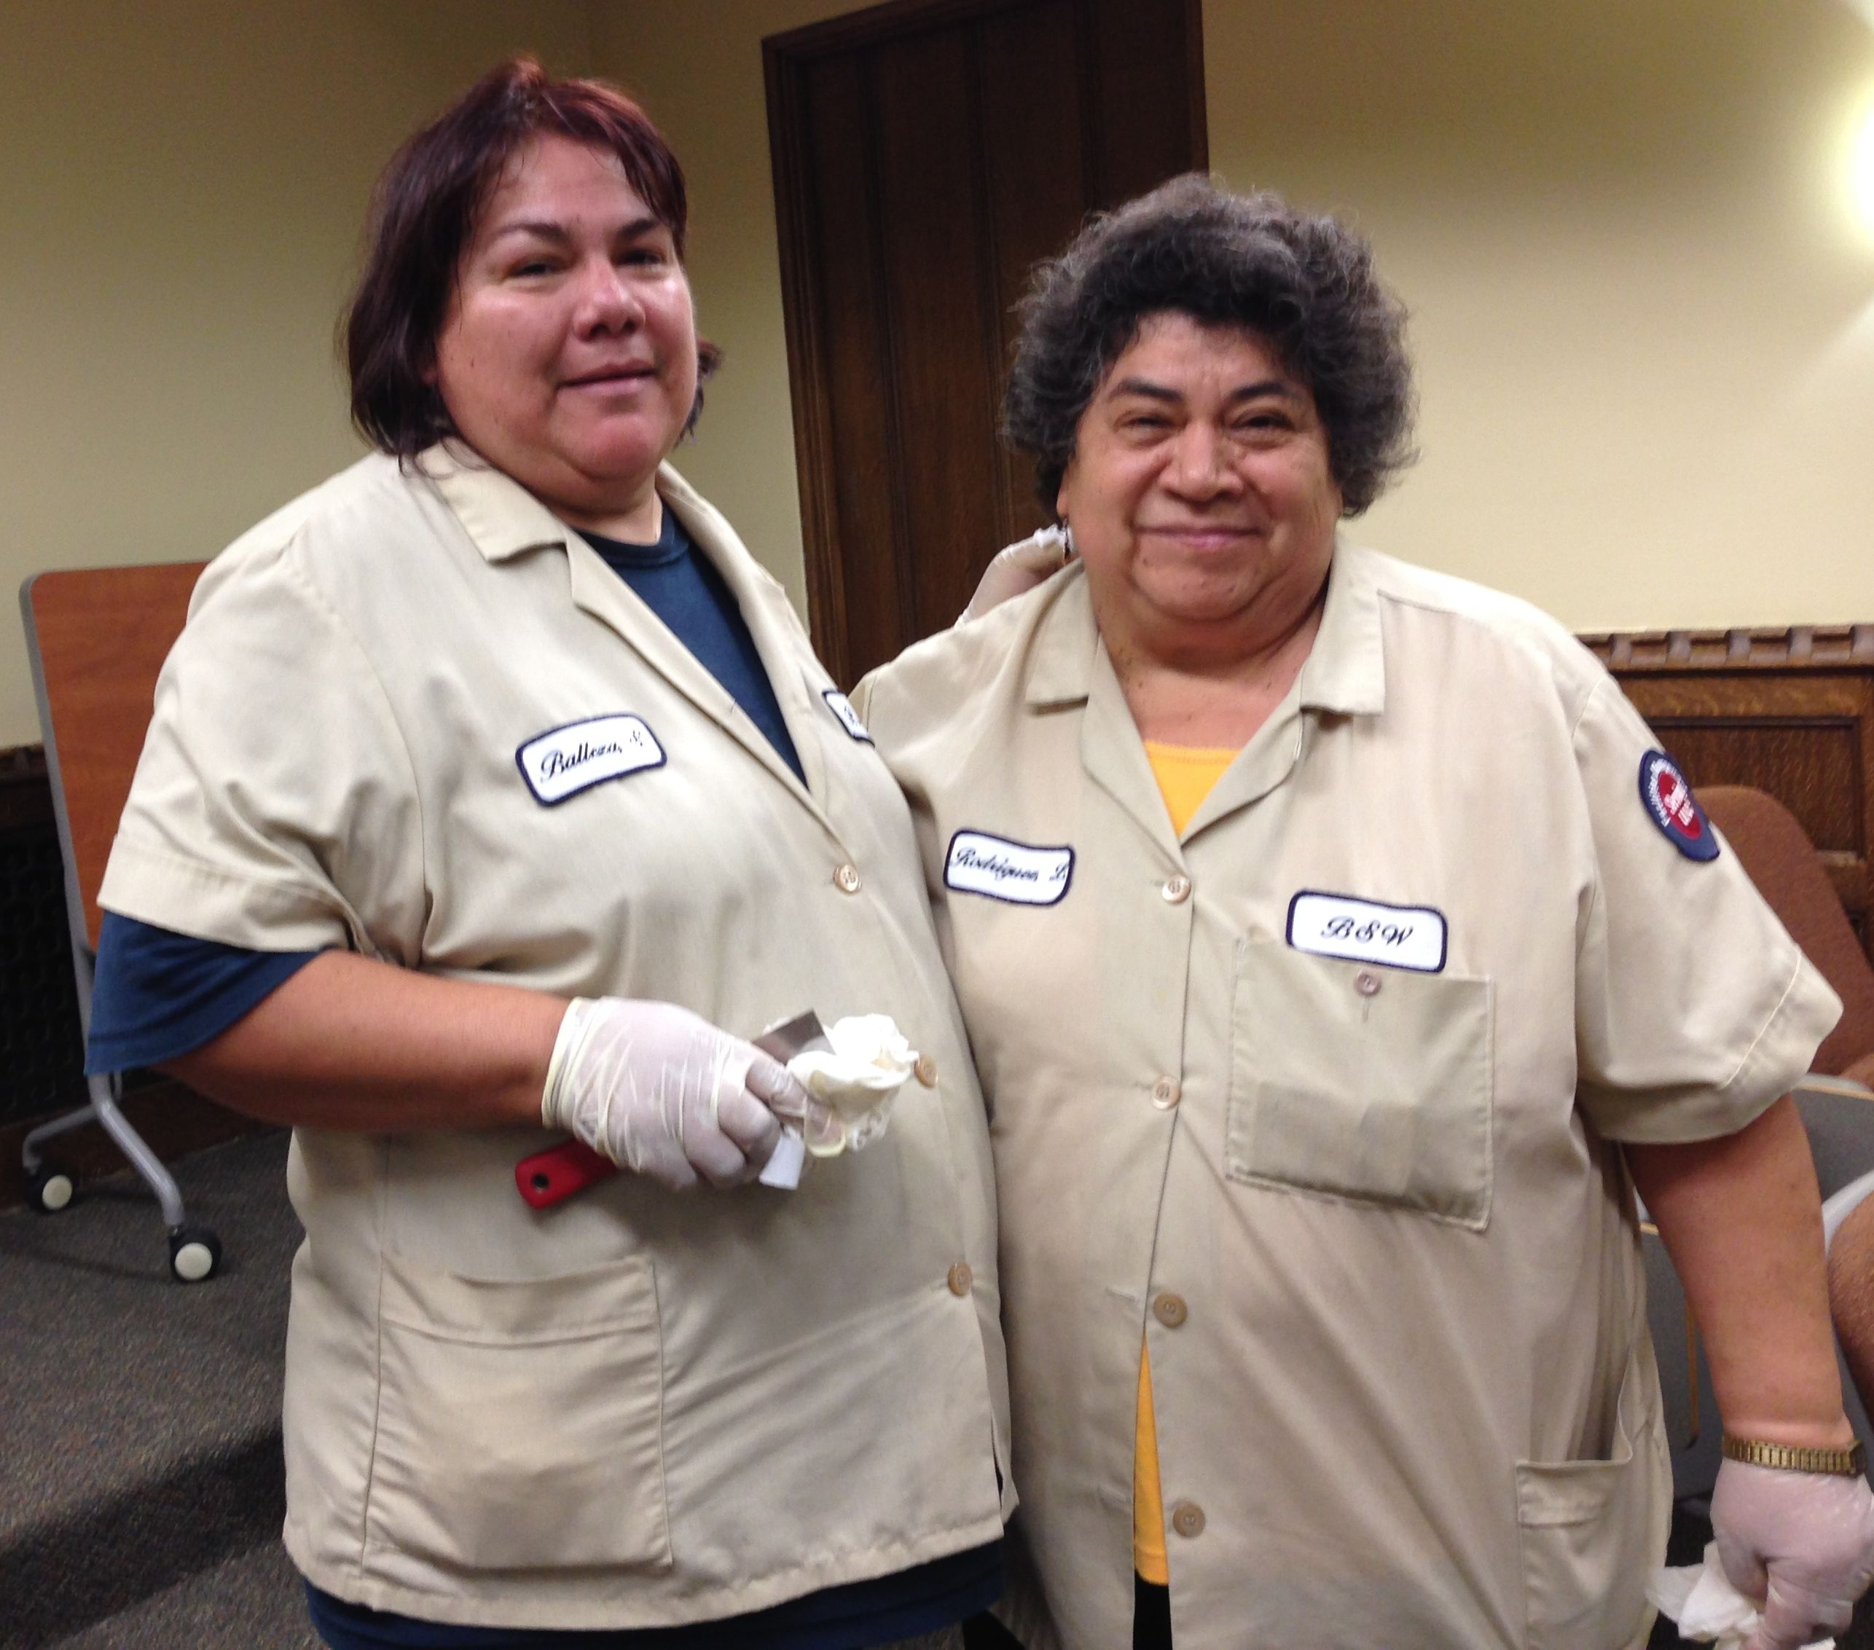
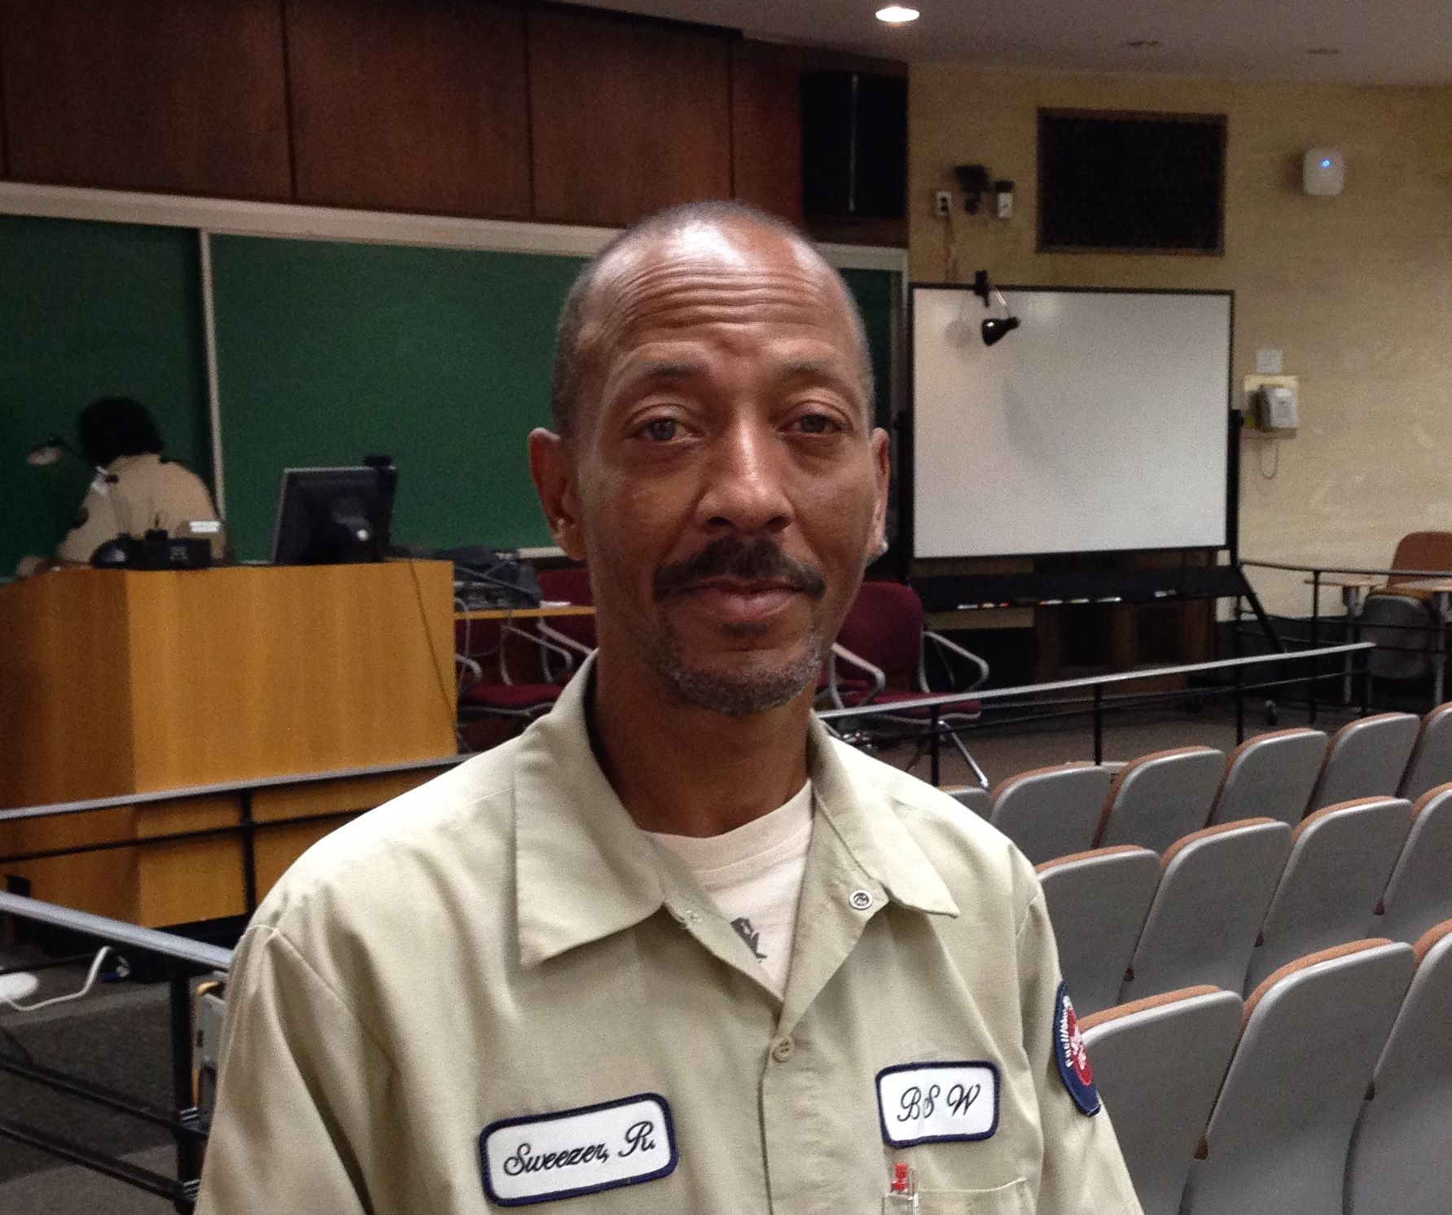
Building Service Staff Members

Slide 12
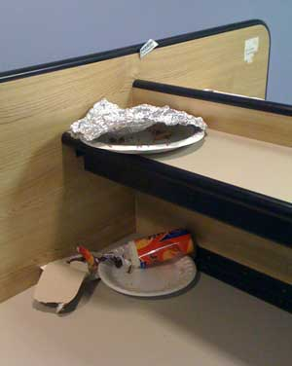
Physical plant issues
Pick up after yourself
Recycle!
Food and Drink
Lounges
Fridges
Microwaves

Slide 13
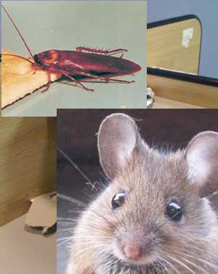
Physical plant issues
Pick up after yourself
Recycle!
Food and Drink
Lounges
Fridges
Microwaves
Do not encourage
these guys to move in

Slide 14
Email at UIC
Do not forward your UIC mail to Gmail, Yahoo, Hotmail, AOL, etc.
GoogleApps@UIC is a suite of tools used for communication and collaboration. It includes Gmail, Google Docs, Google Sites, Google Groups and Google Calendar.
You must create your own GoogleApps@UIC account from the ACCC web site
For more info:
http://accc.uic.edu/service/googleapps/

Slide 15
Back Up Your Data!!
Everyone loses data
It’s a question of WHEN not IF
Easier to get back to work
Use the cloud, an external drive, burn to DVD, save to UIC webdisk, Google Drive, Box, etc.
http://uofi.box.com

Slide 16
Wireless computing at UIC
Much of our building and campus has wireless access
Can print to campus printers
Requires some configuration/set up
For more info:
http://accc.uic.edu/service/wireless/
You can do this yourself!
But see us if you need more help

Slide 17
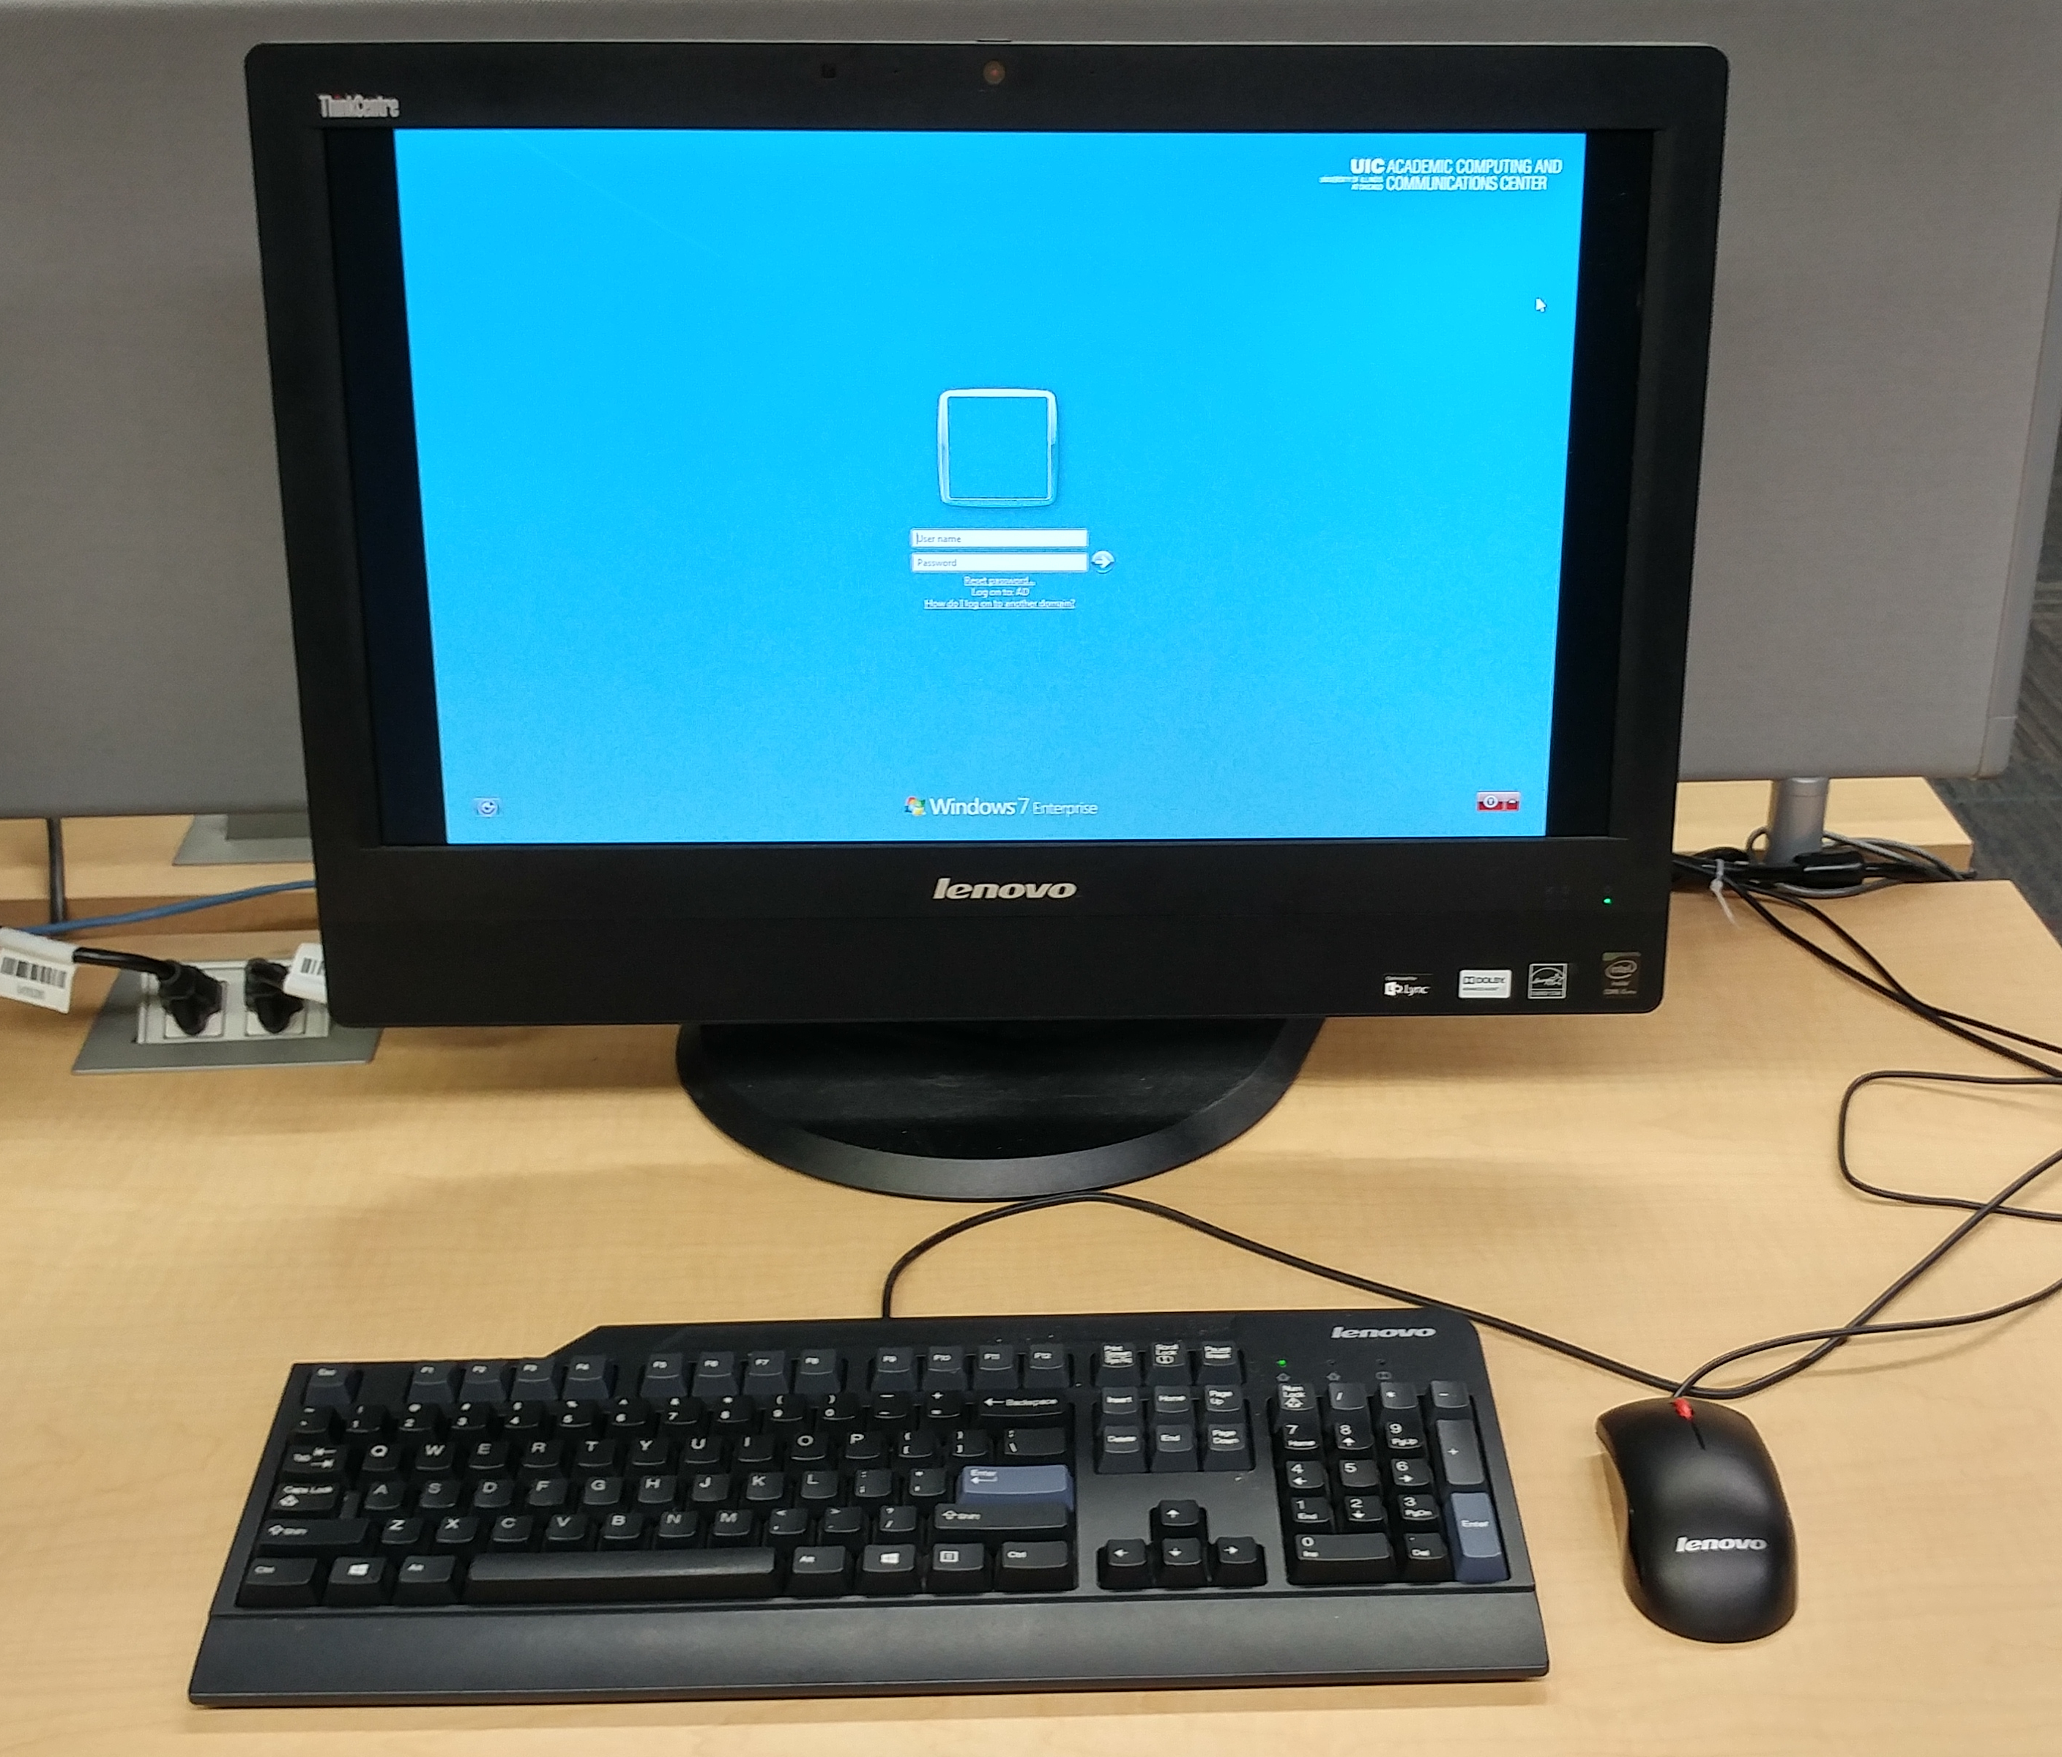
COM Student Computer Lab
6 PCs and 3 Macs
3 Printers in lab
2 black & white HP laser printers
One color printer (costs 10x more to use!)
3 printers upstairs in Learning Ctr

Slide 18
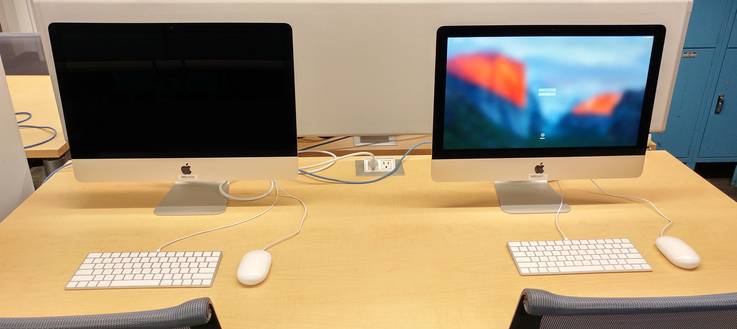
COM Student Computer Lab
Computer software
Microsoft Office, web browsers, etc.
Scanner/ Copier by Blue Lockers
Free scanning to USB sticks (Cannot scan to email)
Copies 10 cents

Slide 19
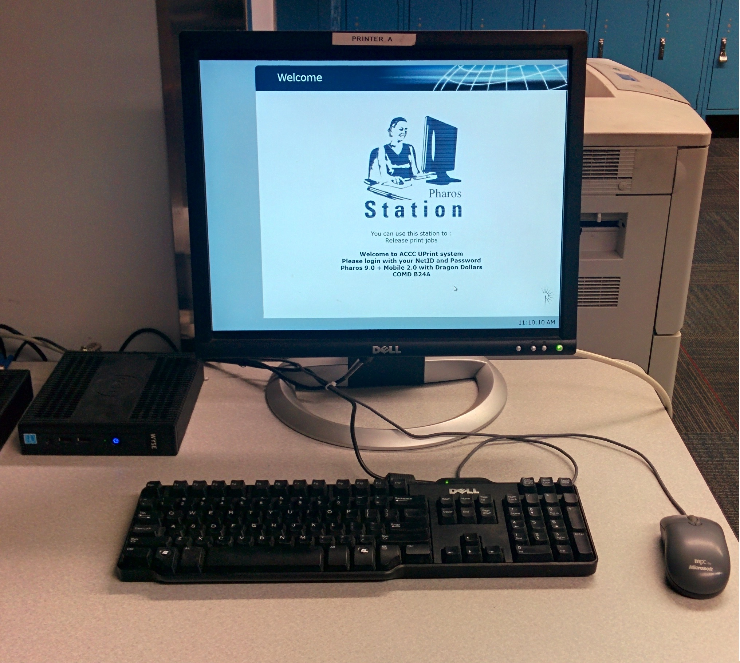
Printing: U-Print system
http://accc.uic.edu/services/printing
We have printers in Edelstone and on floors 2/3/4 in the Learning Center
The job is saved for up to 4 hours,
after that the job is gone
Go to ANY Print station on campus
Login to see list of all documents you
requested to be printed
Select item to print
Can print from wireless too

Slide 20
U-Print continued…
Given $15 allowance per semester for printing
Charges –
If you exceed the allowance, add money to iCard using Dragon $
http://dragoncenter.uic.edu

Slide 21
U-Print FAQ
You get three $15 allowances per year:
Fall, Spring and Summer
It starts at the beginning of each semester, first day of classes
It is NOT taken from your fees
It doesn’t roll over at the end of the semester
Bad print? Stop by Helpdesk in Edelstone and we can reprint it.

Slide 22
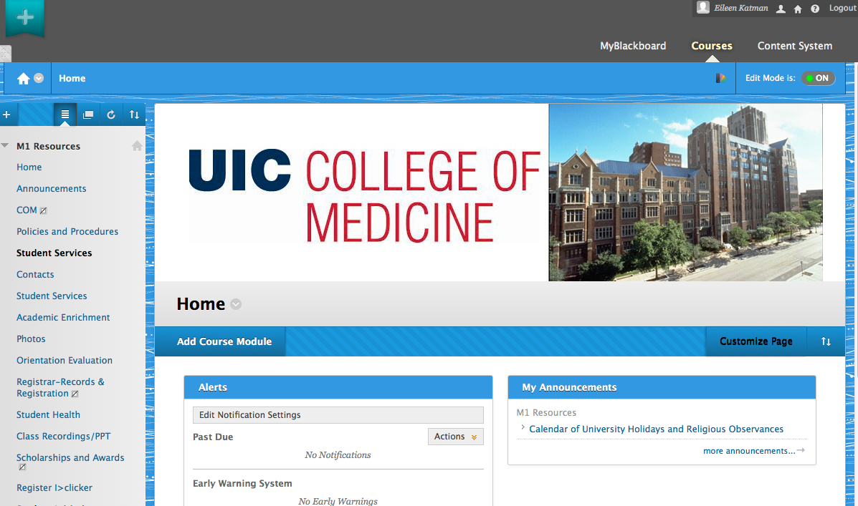
Blackboard.uic.edu

Slide 23
Blackboard.uic.edu
Register for classes!
Read the Syllabus & Schedule
Contact the course director
Need PowerPoint & Acrobat Reader
Free from webstore.illinois.edu
Lecture captures will be linked here and through here you can get to EchoCenter

Slide 24
Echo recordings
You can subscribe to these
Supplement not replacement
Primarily for review
Faculty can opt out
Patient videos
Pre-publication research

Slide 25
Echo recordings

Slide 26
Other Campus Computing Labs
Goldberg building (N.E. corner Taylor & Damen -- 1 block S. and 1 block W.)
Student residence halls
Charge for wireless access in dorm
East side of campus (Daley Library, SEL SCE and other locations)
Same software as Edelstone Computer lab
Same U-Print system with same $15 quota

Slide 27
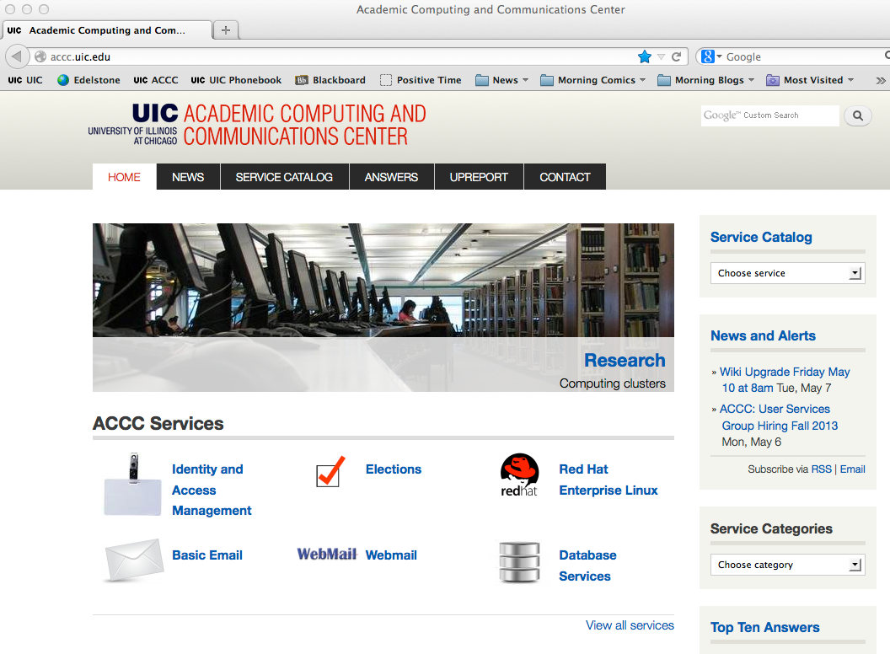
ACCC - http://accc.uic.edu

Slide 28
Software: webstore.illinois.edu
Microsoft Office 365 $FREE
Microsoft Windows Upgrade $FREE
Symantec Anti-virus $FREE
Adobe & Apple software (Reduced cost)
Statistical software and more (prices vary)

Slide 29
Hardware: Microstation
Apple computers
Includes reduced priced laptop bundles
Educational discount
Some parts and accessories
DO NOT BUY Software here, use Webstore
In the bookstore in SCW or at SCE

Slide 30
Questions?
MDPChelp@uic.edu
312-996-3636 – COMD Help Desk phone
From the College of Medicine home page, click on Current Students, then Student Computing Info:
http://chicago.medicine.uic.edu/education/student_services_support/c
For this presentation, from the Edelstone Web page, click on Student Orientation Slide Show
Stop by B26 (Help Desk office)

